Slide 1
Grand Challenge
Transforming K12 Education by Adopting an eLearning Systems Design
Ted Kraver PhD ted@kraver.cc eSATS.org
©2010 eSATS all rights reserved
e01026iNACOL

Slide 2
Education is Heart of Issue
  By failing to prepare students for a 21st Century ‘globalized,’ knowledge-based economy
  We have created a ‘vicious cycle’ of …
  Shrinking State Economy
  Limited Educated Workforce
  70% Leave High School Unprepared
    to Enter Careers/Higher Education
Education
Economy
Workforce

Slide 3
Must Stop Current Practice
Bemoaning Statistics – ‘Good Things to Do’ – Legacy Education:
CANNOT INCREASE 21st Century Readiness

Slide 4
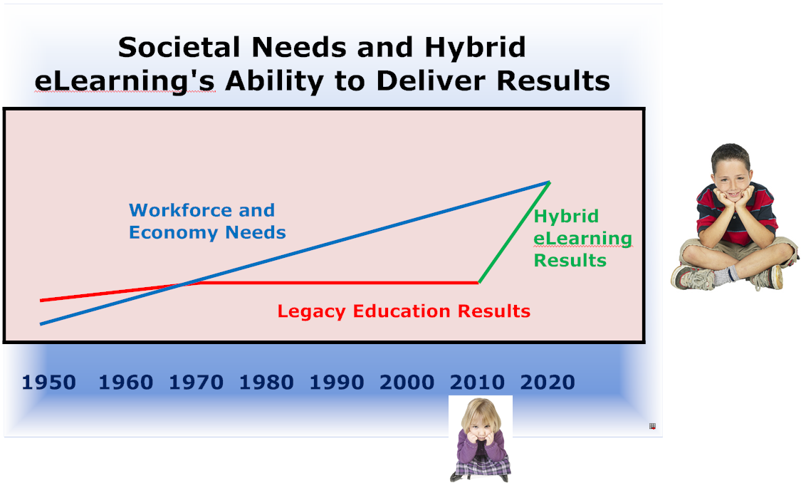
Must Embrace New System
Hybrid eLearning For 1.1 AZ Million Kids
Wilson District – Empire High – Carpe Diem Pioneered Arizona
Mar 2010 - ARRA-EETT $5M Grant -12 Schools for 1 to 1 Programs

Slide 5
Hybrid eLearning Promise
PAYOFF
State Level +
District Level
System Design
NAEP Scores
Effect Factor of
Only 0.3

Slide 6
SILOS ALL WORKING TOGETHER
Implement Systems Design
2011 – Initiate Phase 2
State Level
Extend Physical Infrastructure
Extend Intellectual Infrastructure
District/School Level
Phase 1 – 15 years of Single School Pilots and Programs
Phase 2 – 2012 Implementation 50 Schools, 30,000 Students
Phase 3 – 2013-2019: Entire Arizona Public School System

Slide 7
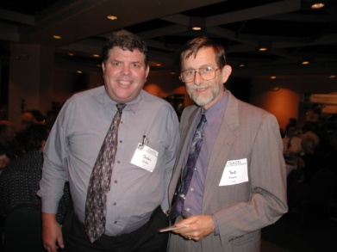
eSATS Systems Buildup
GITA with Federal Funding
State Level - Physical Infrastructure
Broadband Telecom to All Schools
2011 Legislation
State Level - Intellectual Infrastructure
Creating Segments for Federal Funding

Slide 8
SB1452 Intellectual Infrastructure
Digital Learning Center – SBE Establishes with RFP
Under a Private Organization which
Selects Advisory Panel of Seven,
Develops, Provides, Assists, Promotes, Plans:
Hybrid eLearning Models, Academic Performance
Web Based Content, Open Education Resources
Evidence Based Online Digital Content
Contracts with Public and Private Providers
Solicits and Accepts Grants and Donations
Fed
District
School
Teacher-Student
State

Slide 9
SB1452 Intellectual Infrastructure
Post Secondary Teacher Preparation Program
Separate Certification Endorsement
Open Entry, Exit Courses Based on Competency
Eliminate Physical Presence Hours Requirement, Assess Outcomes and Completion
Fed
District
School
Teacher-Student
State

Slide 10



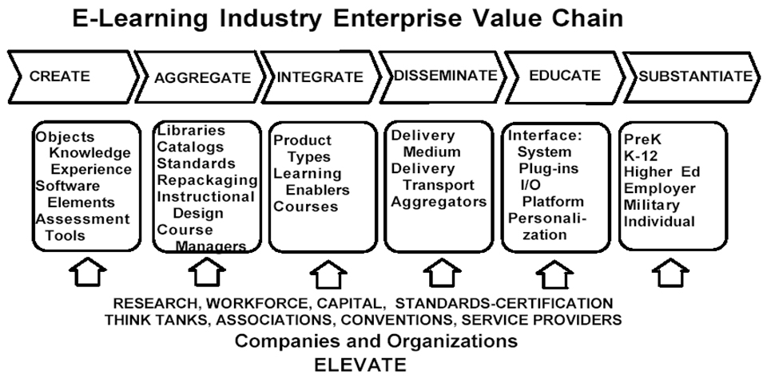
eLearning Enterprise
Being Proposed As Fifth Base Industry
Arizona Strong in eLearning Enterprises
Opportunity to Become the Center of the
Vortex of Global eLearning Enterprise
With a Truly 21st Century Emerging Industry.
e01141Legislation

