Slide 1
American Telemedicine Association
Technology Special Interest Group
Mike Holcomb
Chair, ATA Technology SIG
Associate Director, Information Technology,
Arizona Telemedicine Program
September 22, 2011

Slide 2
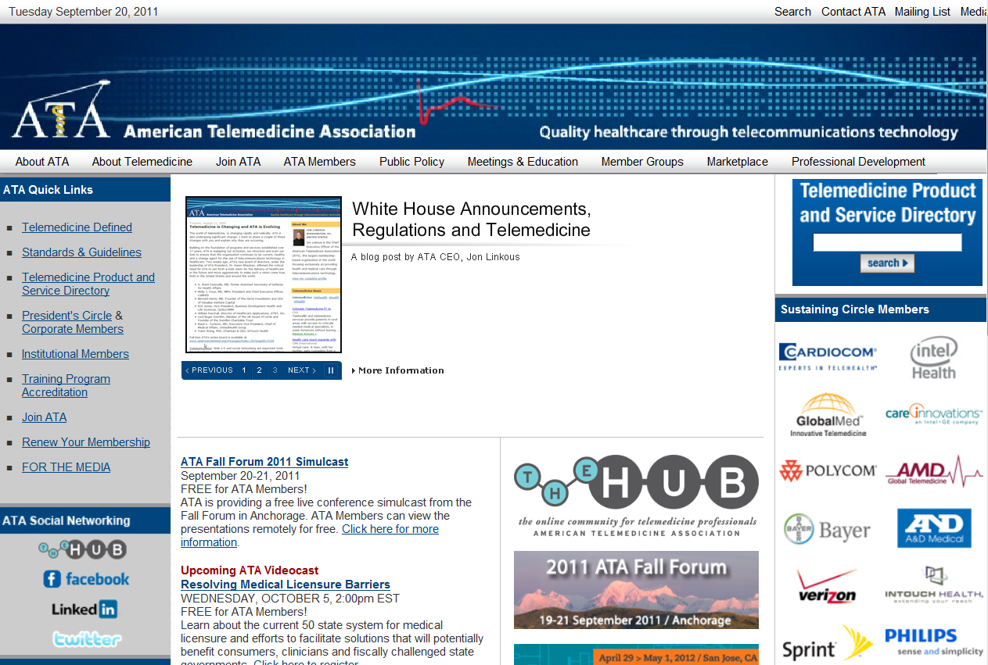
ATA Website http://www.americantelemed.org/

Slide 3
ATA Vision
Fully integrate telemedicine into transformed healthcare systems
Improve healthcare quality, equity and affordability throughout the world

Slide 4
ATA Mission
Promote professional, ethical, and equitable improvement of health care delivery through telecommunications and information technology
  Education
  Clearinghouse
  Networking and collaboration
  Promote research and innovation
  Standards development
  Consumer awareness

Slide 5
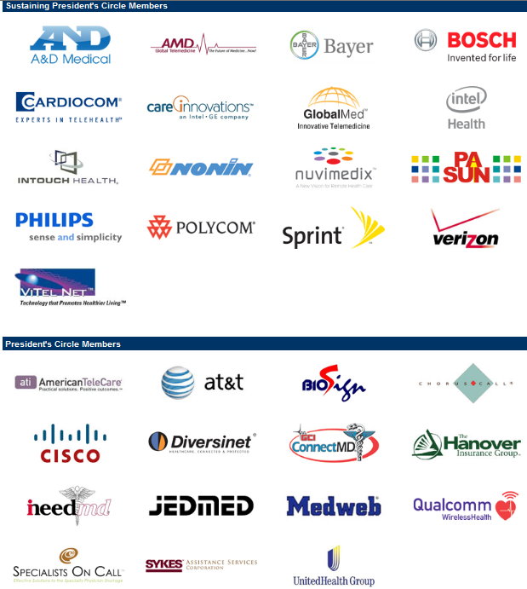

ATA President’s Circle Members

Slide 6
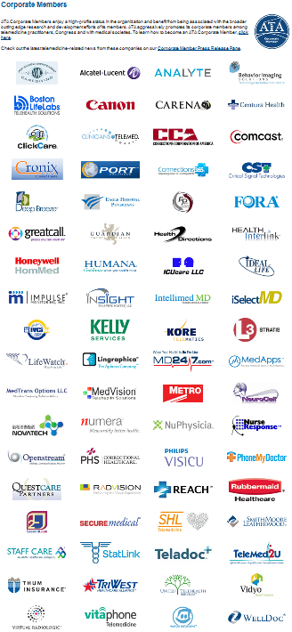
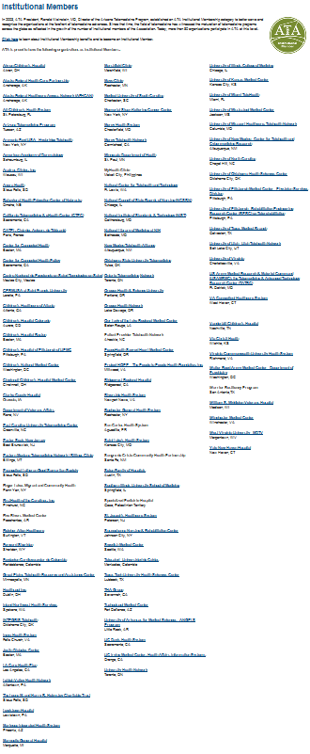
Corporate Members
Institutional Members

Slide 7
ATA Special Interest Groups
ATA Members with similar interests
Share knowledge
Promote and support telemedicine applications within a specialty area
Provide guidance and information to ATA membership under ATA authority
Sponsor activities such as short-courses, presentations or Webinars

Slide 8
ATA Member Groups
Special Interest Groups
Business and Finance | Technology
Home Telehealth & Remote Monitoring | Teledermatology
Human Factors | Telehealth Nursing
International | Telemental Health
Ocular Telehealth | Telerehabilitation
Pediatric Telehealth
Regional Chapters
Latin American & Carribean | Pacific Islands

Slide 9
ATA Member Groups (Cont)
Discussion Groups
Emergency Preparedness and Response | TeleICU
mHealth | Student Member
Policy A-Teams
CPT Coding | Home Telehealth Opportunities in PPACA Implementation
Telehealth Data Exchange | TeleICU Work Group
Medicaid Telehealth Coverage and Reimbursement | Telehealth and Meaningful Use
Councils
ATA Industry Council | ATA Institutional Member Council

Slide 10
ATA Technology SIG Mission
Act as a catalyst for the development of universal access to a contiguous infrastructure of medical communications.

Slide 11
ATA Technology SIG Activities
Sponsor tutorials and seminars for ATA members
Develop and promote interoperability standards for telemedicine equipment
Provide informational support on telemedicine technology to ATA Leadership, other ATA SIGs and ATA Members

Slide 12
ATA Technology SIG Leadership
Leadership May 2010 - May 2012
  Chair
    Mike Holcomb
  Vice Chair
    Charles von Urff, Ph.D.
  Immediate Past Chair
    Richard Evans
  ATA Board Liaisons
    A. Stewart Ferguson, Ph.D.
    Ronald Merrell, M.D.
  ATA Inter-SIG Liaisons
    Volunteers from Technology SIG

Slide 13
References
American Telemedicine Association
  http://www.americantelemed.org/

Slide 14
Thank you!
Mike Holcomb
  mholcomb@telemedicine.arizona.edu

