Slide 1
Telehealth
Technology
Resources
Janet Major, BS
Technical Coordinator, ATP
Distance Program Coordinator, AHSC
Board Member, Telehealth
United States Distance Learning Association

Slide 2

ATIC DHS Wi-FI Security Project for First Responders
Demonstration grant from the information Technology & Evaluation Program (ITEP) or the U.S. Department of Homeland Security
30 mile secure Wi-Fi (801.11X) corridor

Slide 3
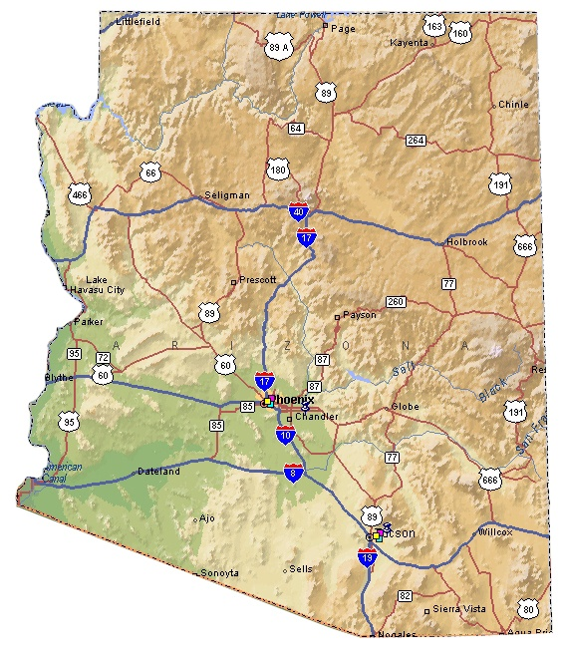
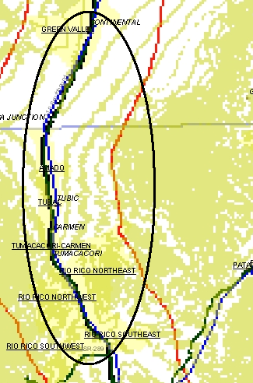
WiFi Corridor Project
Amado

Slide 4


Slide 5
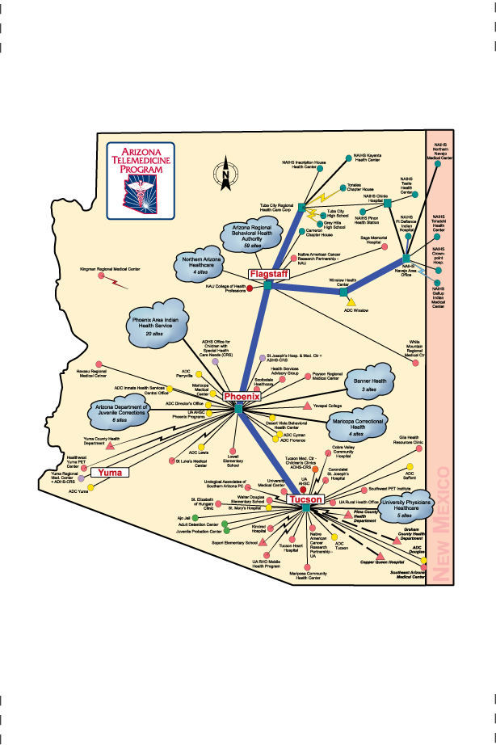
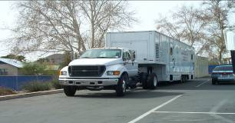
Tuba City Regional Health Care Corporation
Arizona Foundation for the Eye
@ St. Luke’s Medical Center
Children’s Clinics for Rehabilitative Services @
Tucson Medical Center
St. Elizabeth of Hungary Clinic
Mobile Clinic - Amado
Mariposa Community Health Center

Slide 6
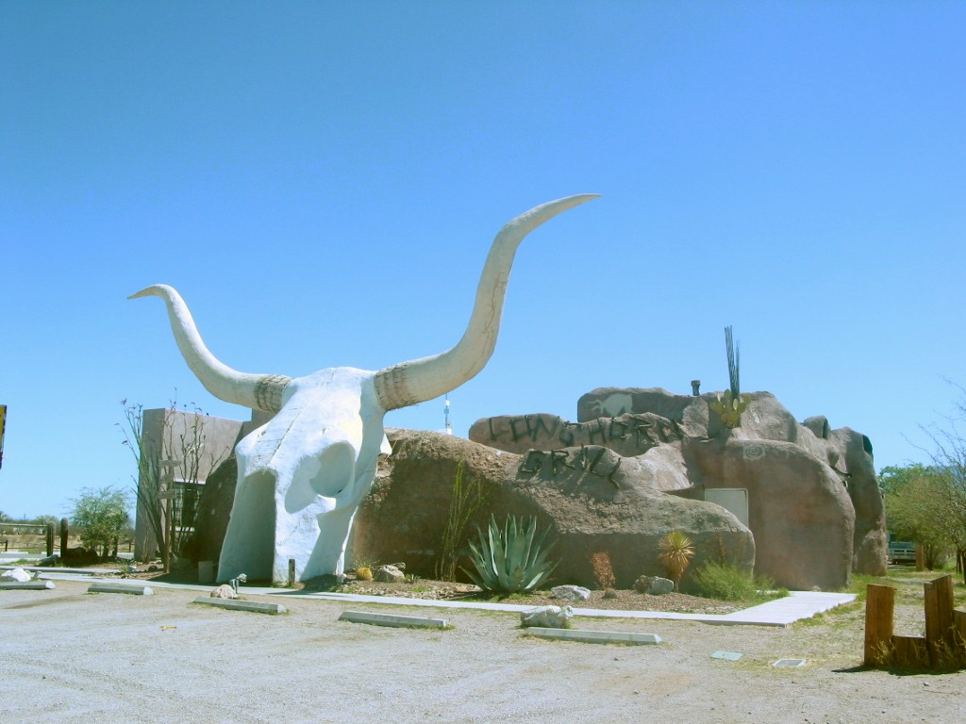
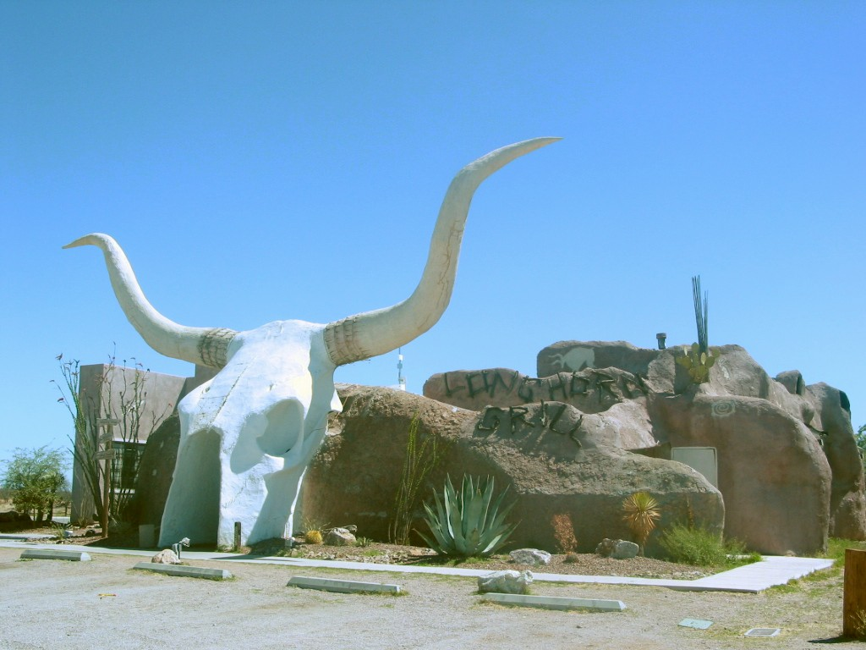


Slide 7
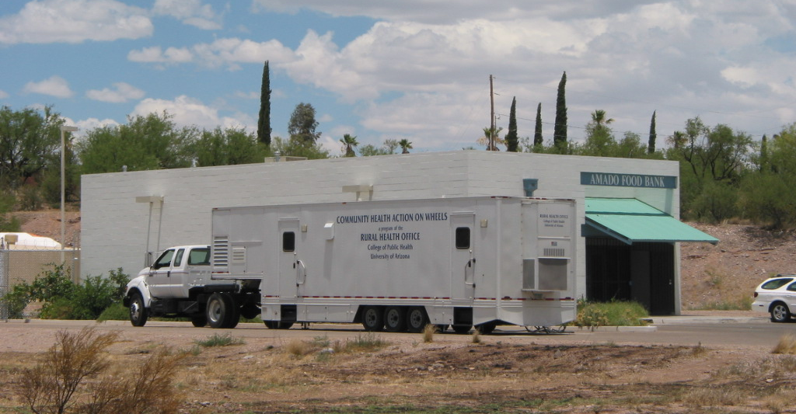
Family & Community Medicine
Mobile Health Program

Slide 8

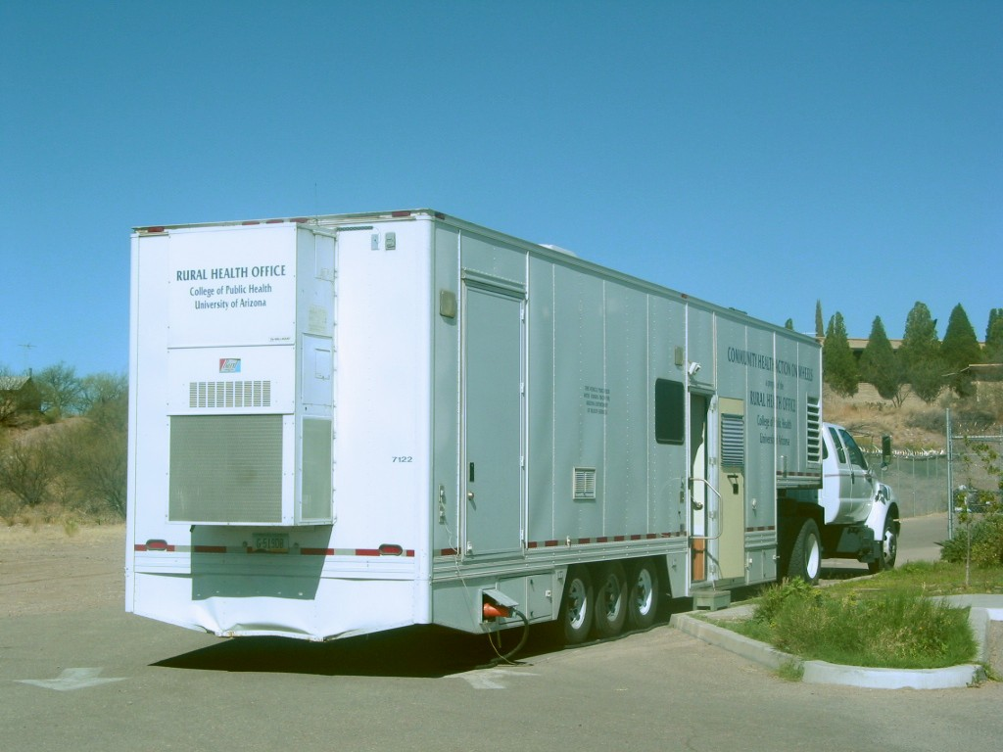

Slide 9
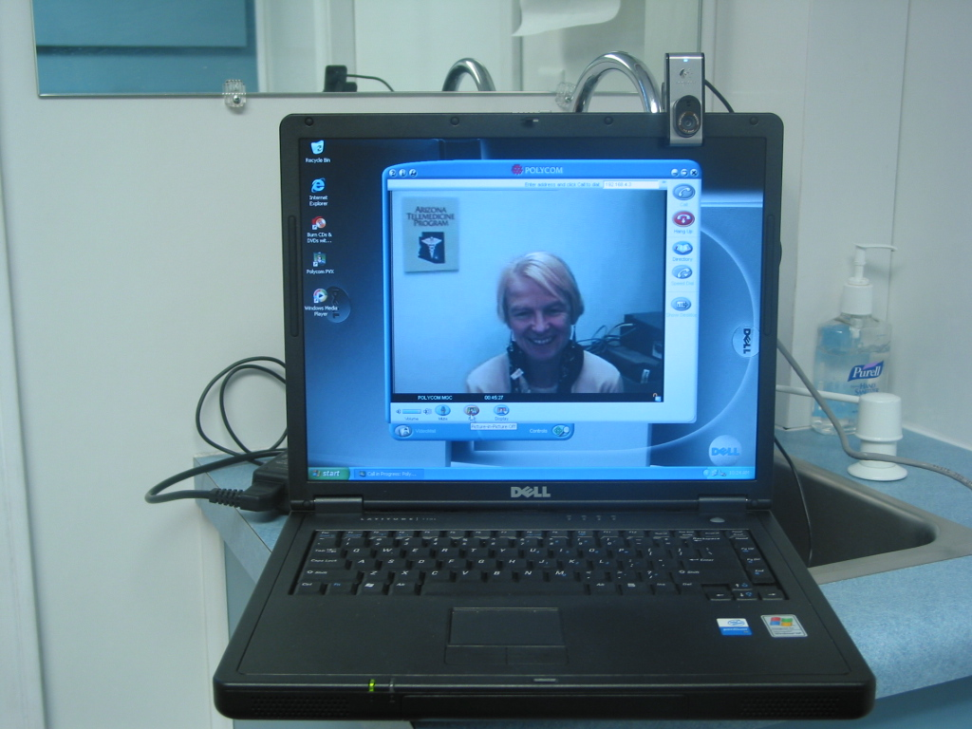
Catherine Robinson, MS, RD, CDE
St. Elizabeth of Hungary Clinic, Tucson

Slide 10
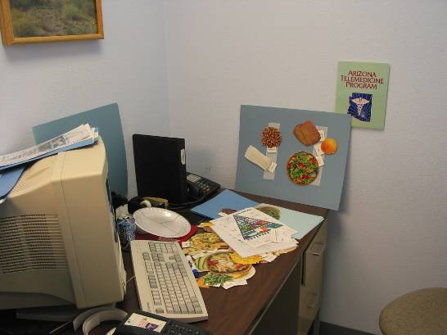

Slide 11
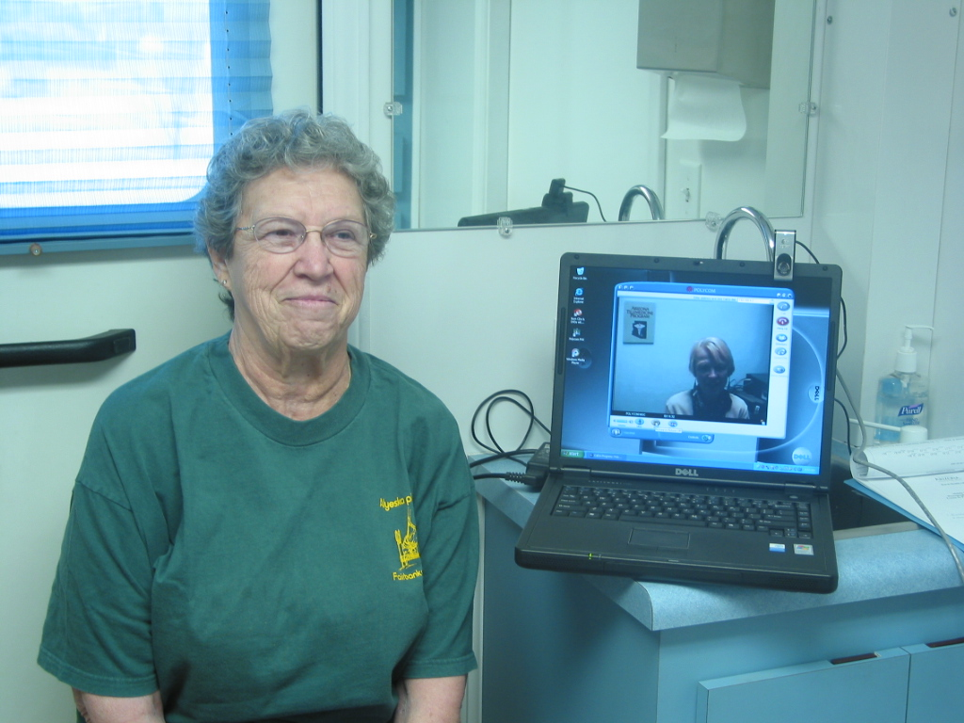

Slide 12
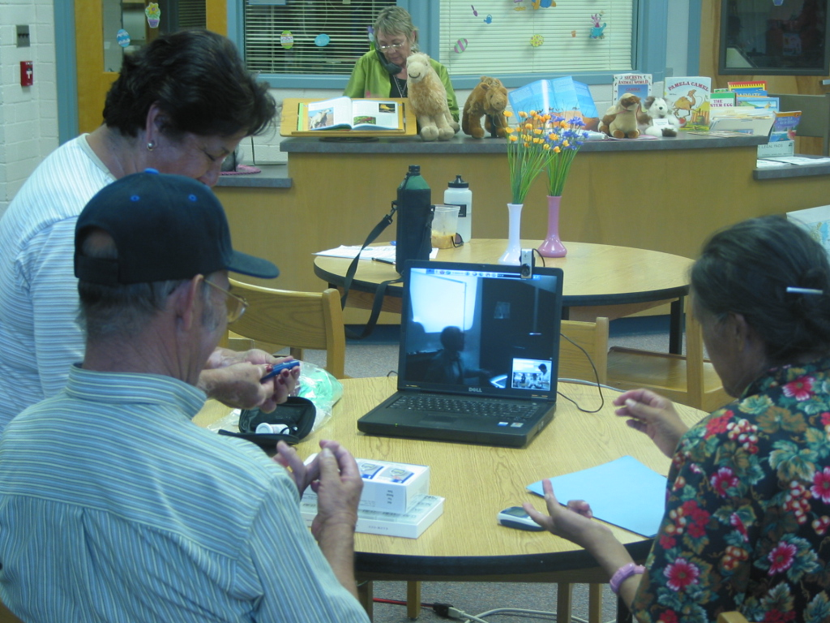

Slide 13
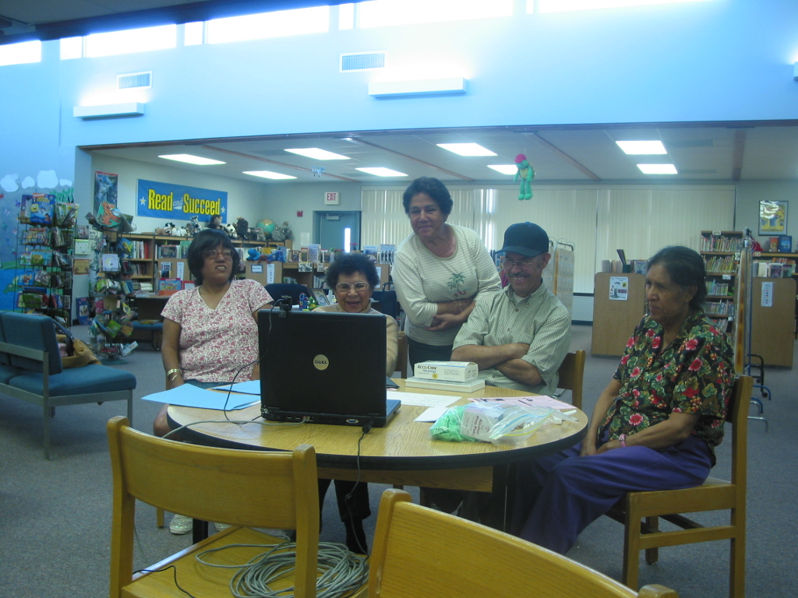

Slide 14
…the rest of the story
Group Code for Nutritional Counseling:
G0270 MNT Group

Slide 15
Telehealth

Slide 16
Telehealth is the delivery of health-related services and information via telecommunications technologies.
Telehealth could be as simple as two health professionals discussing a case over the telephone or as sophisticated as doing robotic surgery between facilities at different ends of the globe.

Slide 17
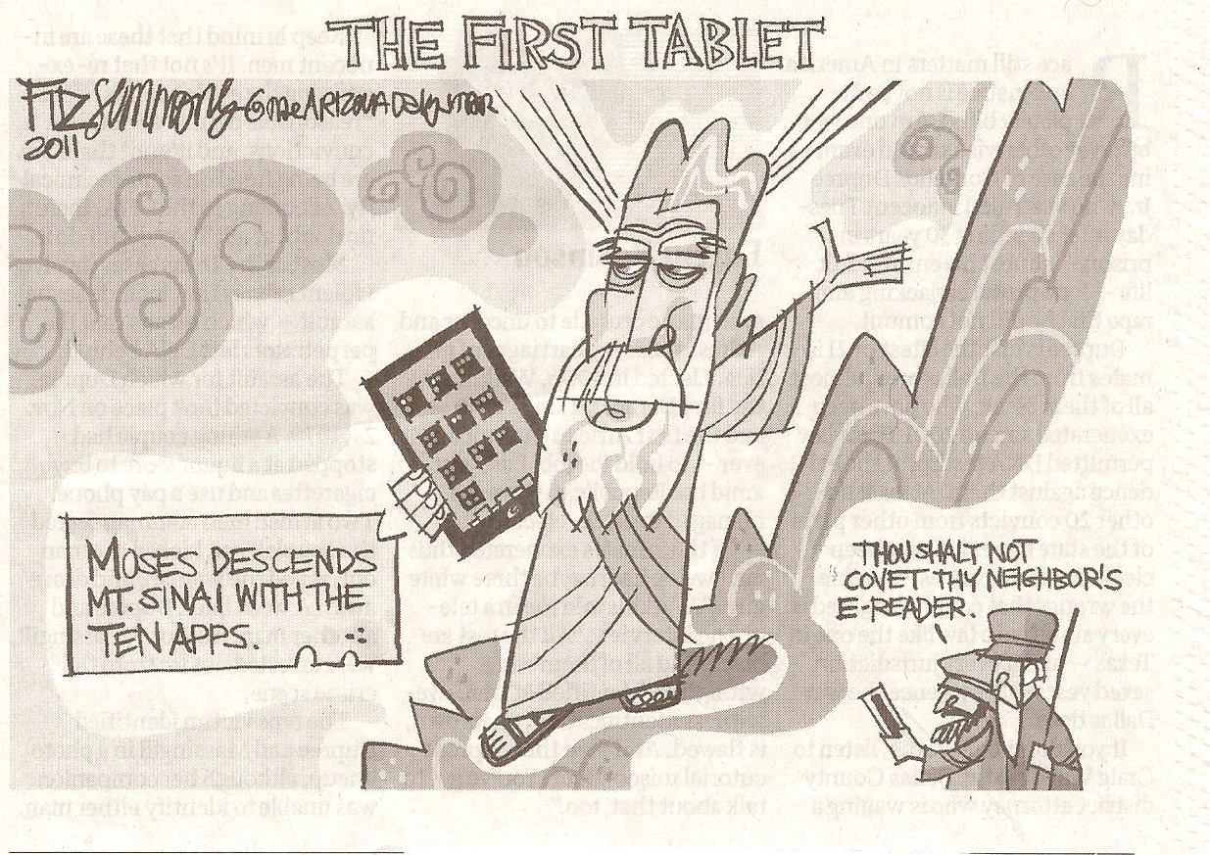

Slide 18
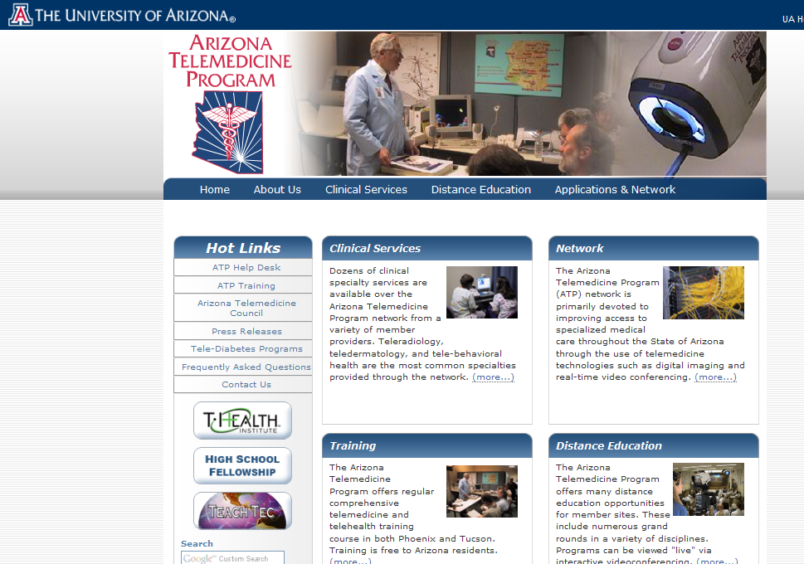
www.telemedicine.arizona.edu

Slide 21

American Telemedicine Association

Slide 22
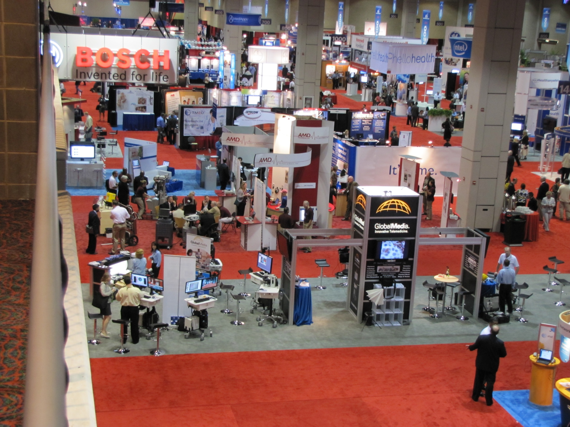

Slide 23
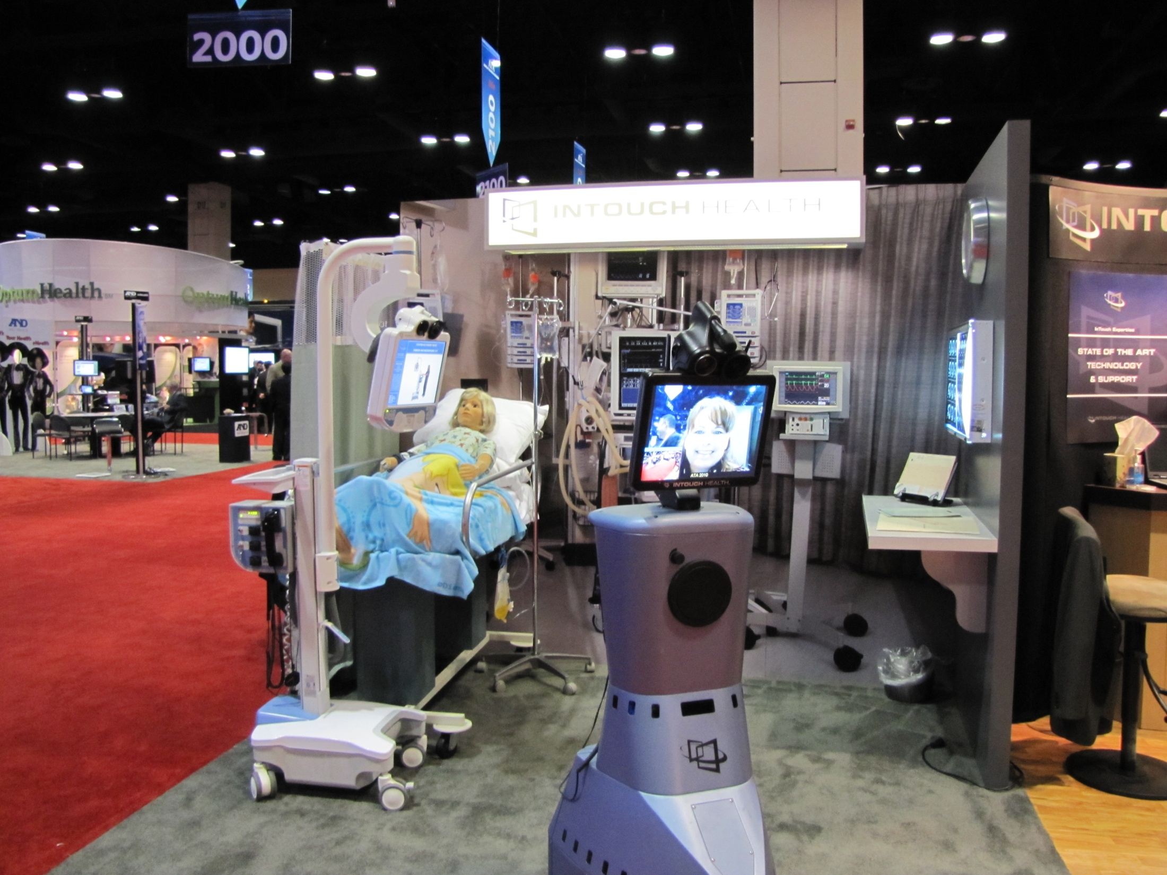

Slide 24
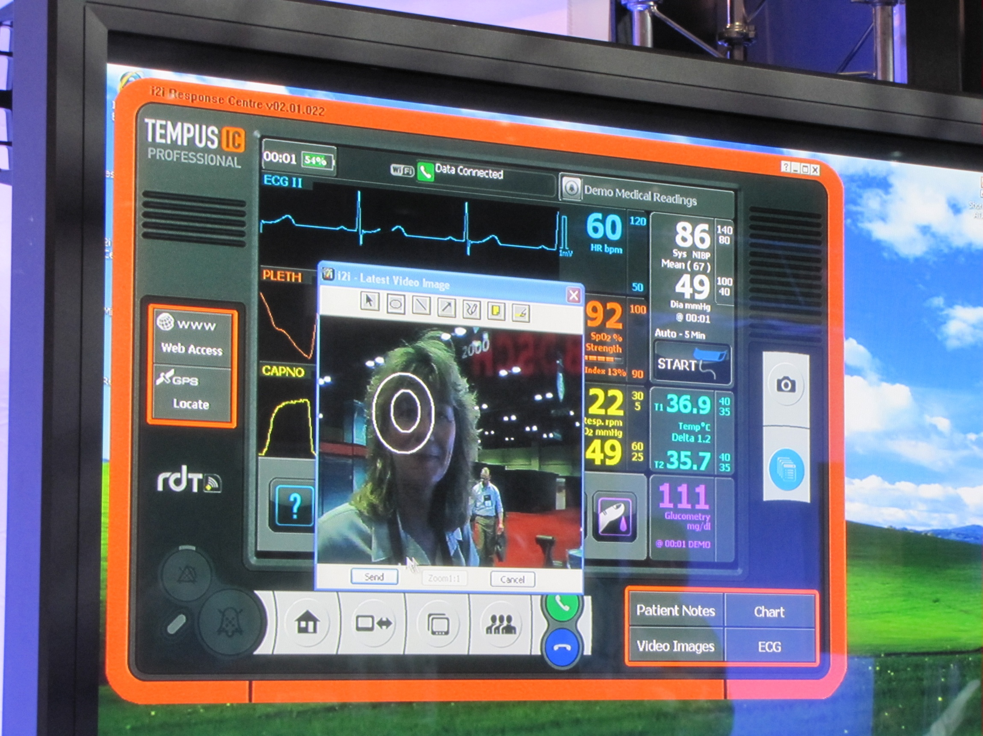

Slide 25
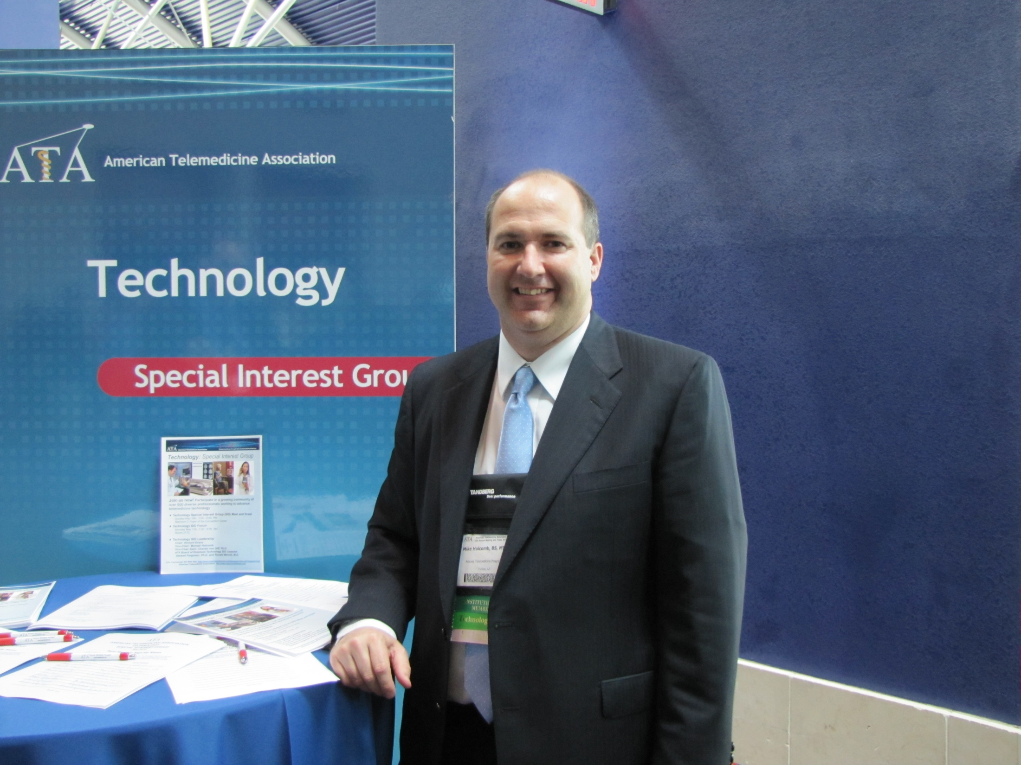

Slide 26
American Telemedicine Association
Technology Special Interest Group
Mike Holcomb
Chair, ATA Technology SIG
Associate Director,
Information Technology,
Arizona Telemedicine Program
September 22, 2011

Slide 27

ATA Website http://www.americantelemed.org/

Slide 28
ATA Vision
Fully integrate telemedicine into transformed healthcare systems
Improve healthcare quality, equity and affordability throughout the world

Slide 29
ATA Mission
Promote professional, ethical, and equitable improvement of health care delivery through telecommunications and information technology
  Education
  Clearinghouse
  Networking and collaboration
  Promote research and innovation
  Standards development
  Consumer awareness

Slide 30


ATA President’s Circle Members

Slide 31

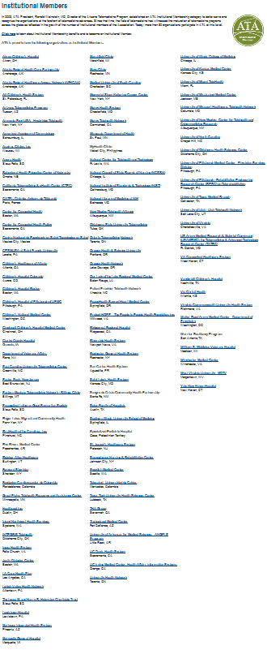
Corporate Members
Institutional Members

Slide 32
ATA Special Interest Groups
ATA Members with similar interests
Share knowledge
Promote and support telemedicine applications within a specialty area
Provide guidance and information to ATA membership under ATA authority
Sponsor activities such as short-courses, presentations or Webinars

Slide 33
ATA Member Groups
Special Interest Groups
Business and Finance | Technology
Home Telehealth & Remote Monitoring | Teledermatology
Human Factors | Telehealth Nursing
International | Telemental Health
Ocular Telehealth | Telerehabilitation
Pediatric Telehealth
Regional Chapters
Latin American & Carribean | Pacific Islands

Slide 34
ATA Member Groups (Cont)
Discussion Groups
Emergency Preparedness and Response | TeleICU
mHealth | Student Member
Policy A-Teams
CPT Coding | Home Telehealth Opportunities in PPACA Implementation
Telehealth Data Exchange | TeleICU Work Group
Medicaid Telehealth Coverage and Reimbursement | Telehealth and Meaningful Use
Councils
ATA Industry Council | ATA Institutional Member Council

Slide 35
ATA Technology SIG Mission
Act as a catalyst for the development of universal access to a contiguous infrastructure of medical communications.

Slide 36
ATA Technology SIG Activities
Sponsor tutorials and seminars for ATA members
Develop and promote interoperability standards for telemedicine equipment
Provide informational support on telemedicine technology to ATA Leadership, other ATA SIGs and ATA Members

Slide 37
ATA Technology SIG Leadership
Leadership May 2010 - May 2012
  Chair
    Mike Holcomb
  Vice Chair
    Charles von Urff, Ph.D.
  Immediate Past Chair
    Richard Evans
  ATA Board Liaisons
    A. Stewart Ferguson, Ph.D.
    Ronald Merrell, M.D.
  ATA Inter-SIG Liaisons
    Volunteers from Technology SIG

Slide 38
References
American Telemedicine Association
  http://www.americantelemed.org/

Slide 39
Thank you!
Mike Holcomb
  mholcomb@telemedicine.arizona.edu
Janet Major
  jmajor@telemedicine.arizona.edu

